Slide 1
The Paradigm as a Radial Category
Tore Nesset & Laura A. Janda
CLEAR-group (Cognitive Linguistics – Empirical Approaches to Russian)
University of Tromsø

Slide 2
Overview
Russian suffix shift
The status of the paradigm
The structure of the paradigm
What structure do we expect for Russian verbal paradigms?
Does Russian suffix shift conform to the expected structure?
What about frequency?

Slide 3

Suffix shift in Russian verbs
An ongoing language change:
Unproductive suffix –a is replaced by productive –aj
  kapljut (with –a) ➝ kapajut ‘(they) drip’
    Slezy kapljut odna za drugoj na klaviši. ‘The tears drip one after another onto the keyboard.’
    Slezy v šči kapajut. ‘The tears drip into the cabbage soup.’
  Well-known, described in the scholarly literature
We examine a database of ca. 20,000 examples from the Russian National Corpus
Suffix shift progresses unevenly through the paradigm

Slide 4
More about Russian suffix shift:
-a suffixed vs. –aj suffixed forms
-aj is the productive pattern
-aj eliminates a consonant alternation (p ~ pl’ in kapat’)
-a vs. –aj forms differ (see handout):
  all Non-Past tense forms
  Present Active Participle
  Gerund
-a and –aj forms are the same:
  Infinitive
  all Past tense forms
These will
be ignored

Slide 5
The status of the paradigm
Paradigms are a legacy from classical grammarians of Greece and Rome
Some contemporary linguistic theories reject the paradigm altogether:
  Item & Arrangement/Item & Process (Hockett 1958)
  Distributed Morphology (Halle & Marantz 1993)
  in such theories, the lexicon contains morphemes, the grammar specifies rules for combining them

Slide 6
Evidence for paradigms
McCreight & Chvany (1991) show that paradigms facilitate better descriptions of syncretism than syntactic featuers
Milin et al. (2008) report that increased complexity of paradigms yields longer response times in psycholinguistic experiments

Slide 7
The structure of the paradigm
 | Sg | Pl
1
2
3
Aristotelian category
  An unordered list of inflected forms
  All forms have the same status
  Paradigms lack internal structure
  Word & Paradigm (Matthews 1972)
Radial category (Lakoff 1987)
  Paradigms have internal structure
  Prototypical vs. peripheral forms
Can the question of paradigm structure be investigated empirically?

Slide 8
Our approach
Language change: empirical predictions
  Paradigm = aristotelian category
    All forms affected to same degree
  Paradigm = radial category
    Peripheral forms affected most
Statistical analysis
  Logistic Mixed Effects Modeling
  Systematic analysis of various factors
  Thanks to R. Harald Baayen
 | Sg | Pl
1
2
3
 | Sg | Pl
1
2
3
Our analysis indicates that paradigms have structure.

Slide 9
What structure do we expect for Russian verbal paradigms?
What parts of the paradigm should be prototypical vs. peripheral?
What categories are expressed in the Russian verbal paradigm?
  finite vs. non-finite
  indicative vs. imperative
  person
  number

Slide 10
finite vs. non-finite
In Russian, gerunds and participles are non-finite because they cannot express mood
Finite forms are more prototypical than non-finite forms (Bybee 1985, Joseph 1983)
non-finite forms:
gerund, participle
all finite forms
more prototypical
more peripheral

Slide 11
indicative vs. imperative
Indicative is more prototypical since it represents the simplext relationship of a situation to reality
Typologically verbs rarely lack indicative forms, but there are often verbs that lack imperative forms (modals, perception verbs)
Imperatives have reduced person opposition and clitic placement (Joseph 1983)
all indicative forms
imperative
more prototypical
more peripheral

Slide 12
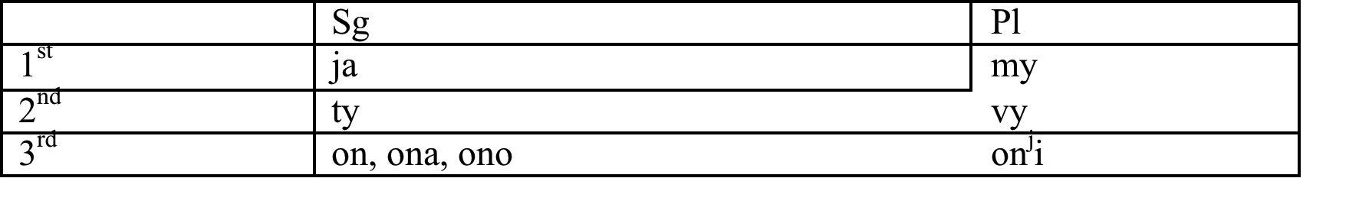
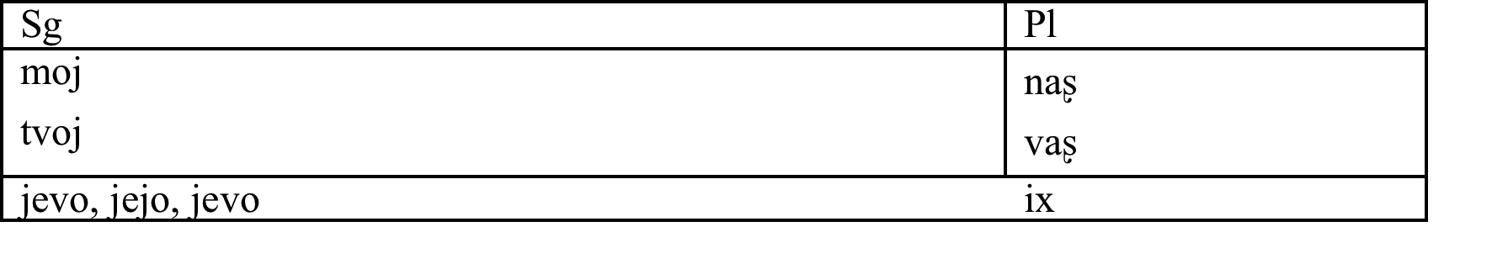
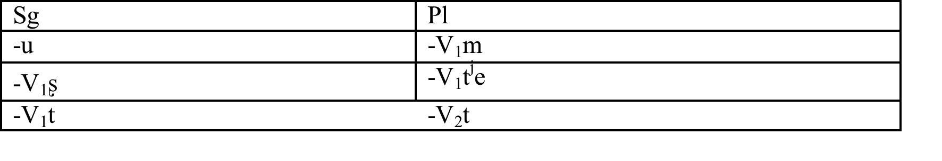
Relationship between person and number
The major distinction is: 3rd person vs. 1st/2nd person. This indicates that person ranks above number.

Slide 13
3rd person vs. 1st & 2nd person
Typologically zero expression is more common for 3rd person than for 1st & 2nd person (Bybee 1985)
3rd person is unmarked (Lyons 1977)
1st & 2nd
person
3rd person
more prototypical
more peripheral

Slide 14
singular vs. plural
Cross-linguistically, singular is unmarked (Janda 1995, Corbett 2000, Lyashevskaya 2004)
singular
plural
more prototypical
more peripheral

Slide 15
Prototypical vs. peripheral forms
Categories
Finite
Non-finite
Indicative
Imperative
Participle/gerund
3. person
1./2. person
Singular
Plural
3sg > 3pl > 1&2 > imperative > participle/gerund
Prediction:
Most conservative (-a)
Prediction:
Most innovative (-aj)

Slide 16
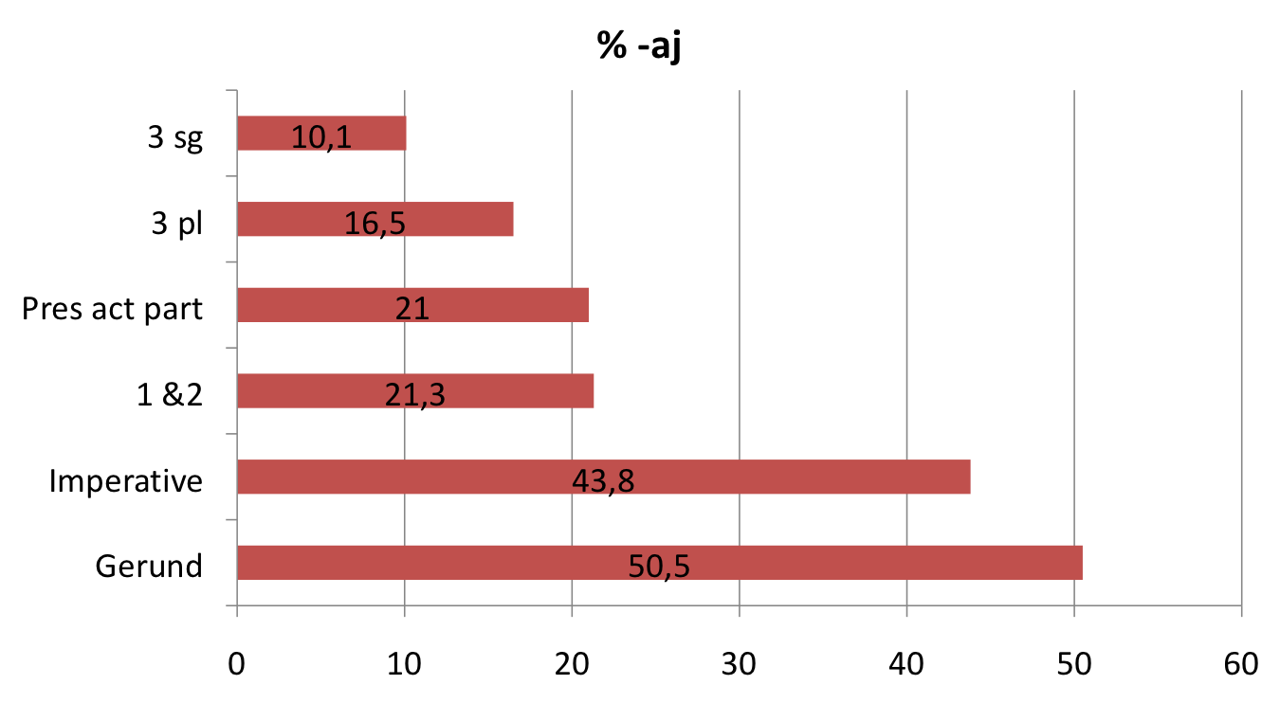
Results
NOT statistically significant
Other differences are statistically significant

Slide 17
Predictions vs. results
Predictions:
  3 sg
  3 pl
  1. & 2. person
  imperative
  gerund/participle
Results:
  3 sg
  3 pl
  1. & 2. person/participle
  imperative
  gerund
The results indicate that the predictions are correct.
Problem: The participle behaves like a finite form.

Slide 18
Why does the participle behave like a finite form?
Hypothesis:
  Form overrides prototypicality
3 pl has suffixes: -ut ~ -at
Part. has suffixes: -ušč ~ -ašč
“Parasitic formation”:
  The participle “borrows” the vowel from the 3pl form
  This formal resemblance relates the participle to the finite forms
  This formal resemblance influences the participle, causing it to behave like a finite form in relation to suffix shift

Slide 19
What about frequency?
Alternative hypothesis:
The least frequent forms are most prone to undergo suffix shift
Prototypicality ranking:
    3 sg
    3 pl
    1. & 2. person
    imperative
    gerund
Frequency ranking:
    3 sg
    3 pl
    gerund
    1. & 2. person
    imperative
Frequency yields incorrect predictions for the GERUND.
Notes:
Her ser vi bort fra partisippet som vi allerede har diskutert. Det er jo problematisk hva enten man antar prototypikalitet eller frekvens som forklaringsmodell.

Slide 20
Frequency: Written vs. Spoken
Perhaps the gerund has high frequency because spoken Russian is underrepresented in the corpus?
 | # lemmas | # gerunds | % gerunds
Whole corpus | 13,581,979 | 501,036 | 3.7
Spoken corpus | 135,326 | 1,522 | 1.1
Difference is statistically significant (p<2.2e-16)
Effect size is less than “small” (Cramers V=0,01)
Indicates that frequency difference between spoken and written language has minimal impact
Cannot exclude the possibility that frequency is relevant
Notes:
Forklaring av forskjellen mellom signifikans og effektstørrelse:
signifikans = hvor sannsynlig det er at noe skyldes en tilfeldighet
effektstørrelse = et mål på hvor sterk sammenheng det er mellom to variable i en statistisk populasjon
Eksempel: Slankekur
En statistisk analyse kan vise at det er en sammenheng mellom å gjennomgå kuren og å veie mindre, dvs. at de som gjennomgår kuren blir tynnere, og at dette ikke kan skyldes en tilfeldighet.
Men dette sier ingenting om effekten av slankekuren: Blir man 1 gram eller 20 kilo lettere? Effektstørrelsen måler dette.
Cramers V < 0,1 regnes som liten effektstørrelse. For gerundiene er effektstørrelsen bare 0,01 – altså en tiendedel. Dette tyder på at det ikke er tilfeldig at det er færre gerundier i det muntlige korpuset, men at det er så få gerundier uansett at forskjellen på muntlig og skriftlig språk har liten effekt.

Slide 21
Summary
Suffix shift
  is sensitive to morphosyntactic features:
    3sg is most conservative form (–a)
    Gerund is most innovative (–aj)
Pardigm structure:
  Results are compatible with the hypothesis that paradigms are radial categories with internal structure
Frequency:
  It is possible, but not likely, that frequency is of decisive importance

